Slide 1

Team:Nexsus

Slide 2
Team:Nexsus

Slide 3

Problem Statement
AI POWERED MEDICAL RECORD SUMMARIZATION
Medical records often contain a vast amount of information
Medical Summarization
Retaining critical details

Slide 4
Project Concept
Effective AI Model Selection and Training
User-Centered Design and Usability
Scalability and Real-World Applicability

Slide 5

INNOVATION
It uses cutting-edge technology
Module of langchain & Hugging face
Faster and more accurate Report Analysis
Decrease in time Summarization
Improved patient engagement

Slide 6
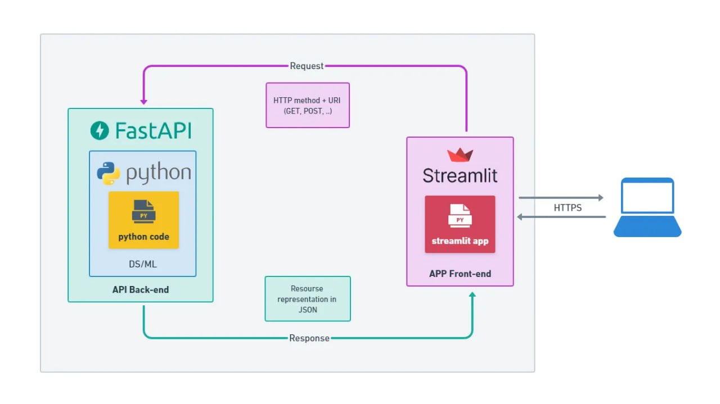
Feasibility:
The Design Process

Slide 7

Benefits of AI-Powered Medical Records Summarization
Condensing Information
Efficient Extraction
AI can summarize lengthy medical records, condensing them into concise summaries while retaining vital details, saving time for healthcare providers.
By extracting essential information quickly, AI-powered summarization streamlines workflows and enables more focused and effective patient care.
Informed Decision-Making
Enhanced Productivity
With AI-generated summaries, healthcare providers have access to critical information at their fingertips, facilitating more informed decision-making.
AI-powered summarization reduces the time spent on reviewing lengthy records, freeing up healthcare providers to focus on other important tasks.

Slide 8


Slide 9
Team: Nexus
Mehak Banu – 2110030264
Shireen - 2110030105
M Shashank – 2110039485
K Ganesh Reddy-2110039467
G Yashwanth Reddy – 2110039470

